Slide 1
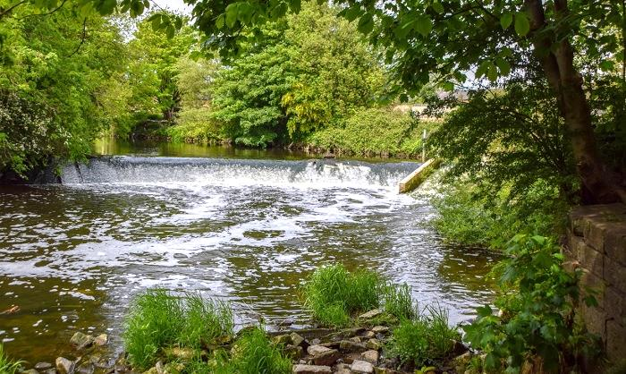
Investigating the influence of flood mitigation strategies on return periods and river dynamics
Mathematics of
Flooding Events
Mathematics of
Flooding Events

Slide 2
HELLO! I’m Faye
I am currently a fourth yeah Mathematics student at the University of Leeds.
My research revolves around river flooding in the UK.

Slide 3
Table of Contents
1
2
3
4
Aims
River Dynamics and shallow water theory
Shallow water theory
Subcritical and supercritical flow
Weirs
Plotting a river profile
Calculating flood storage volume
Conclusion
Further study

Slide 4
Aims
I
II
Flood risk and management
Demonstrate what return periods are and examine the tools aimed at explaining return periods
Investigate the use of flood mitigation strategies and their effectiveness in reducing return periods
River dynamics and shallow water theory
Apply shallow water theory to model the behaviour of fluid passing over a weir
Calculate the flood storage volume created by a weir, applying this to a real life example

Slide 5
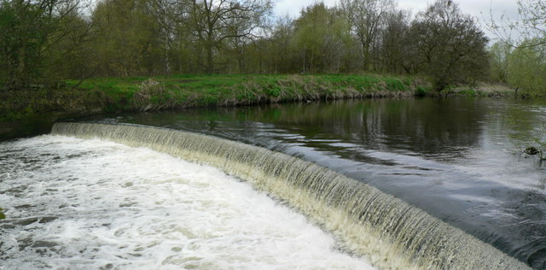
Shallow water theory assumptions
Shallow depth
One-dimensional flow
Laminar flow
Small bed slope
Flow varies smoothly and is subcritical
Incompressible flow

Slide 6
Shallow water theory equations
Continuity Equation
Momentum Equation

Slide 7
Subcritical and Supercritical flow
The Froude number:
Affected by shape, slope and roughness of the channel.
Critical depth – Depth for which the mean specific energy is minimum - velocity and gravitational forces are balanced.
Flow | Froude Number | Flow properties
Subcritical | Fr < 1 | Slow and tranquil
Supercritical | Fr > 1 | Fast and rapid
Critical | Fr = 1 | Flow depth = critical depth

Slide 8
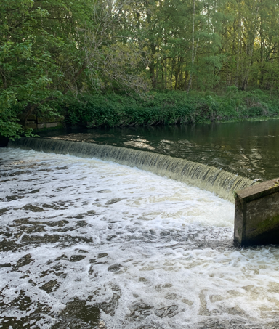
Weirs
Hydraulic structures used to monitor flow and provide some flood defence
Obstruct the usual flow and hold back a certain volume of water - the flood storage volume
Two types
Sharp-crested - sharp-edged flat plate spanning across a river
Broad-crested - smooth or flat horizontal weir plate

Slide 9
Discharge over a broad crested weir
For a rectangular weir,
Assumptions
Shallow water theory assumptions
Steady state - h, u and Q are independent
of time
Velocity is uniform at any point
before the weir (at ϵ) and non-uniform at some point over the weir (at 1)
Negligible channel slope
Constant river and weir width

Slide 10
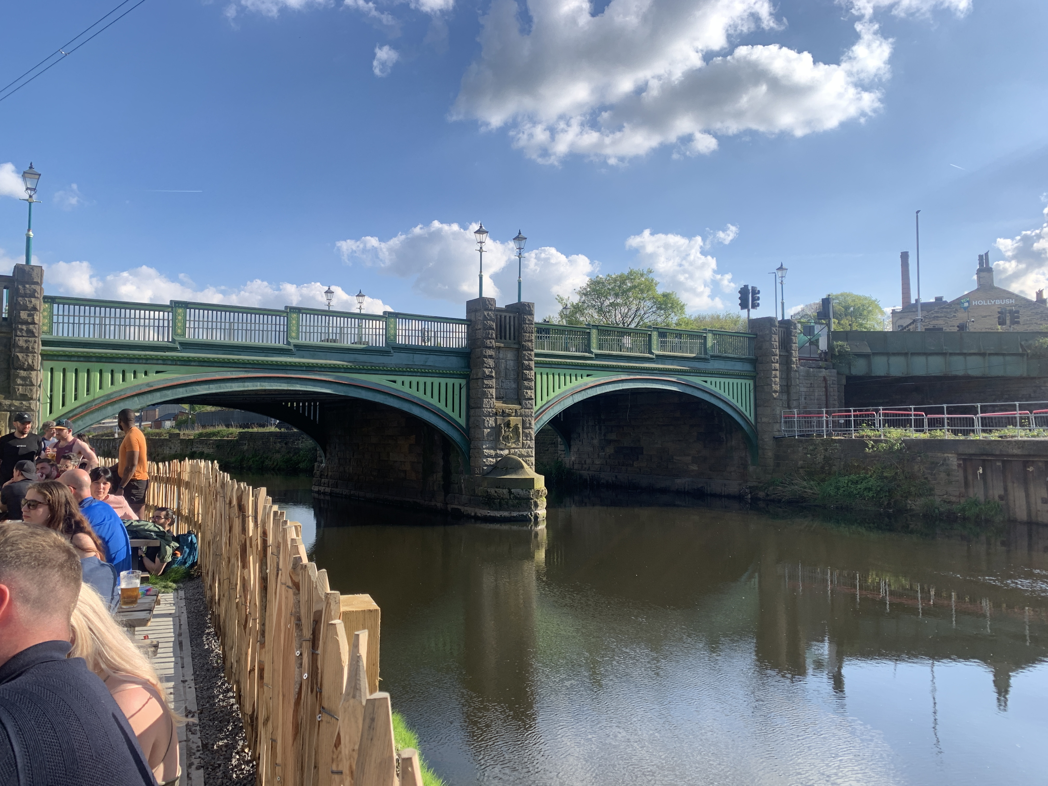
Plotting a river profile
Assumptions
Shallow water theory assumptions
Weir will be smooth and modelled as a broad-crested weir
Rectangular shaped weir and channel
Constant river slope and constant channel width
Channel width = weir width
Initial river height approximation
Have a constant height, which ‘backs up’ at the introduction of a weir
h₀ - upstream water depth, before any influence of the weir.
s₁ - point at which the upstream uniform flow meets downstream non-uniform flow
tan α – gradient of river bed slope
sₓ – crest of the weir

Slide 11
1. Finding h₀
Rearrange the equation for discharge via Manning’s relation:
to give
Solving for h₀, the equation becomes

Slide 12
1. Finding H and hϵ
The head of the weir, H, is found by rearranging the equation for discharge over a broad-crested weir
hϵ is the combined height of the head of the weir, H, and the weir height, Pw:

Slide 13
1. Finding s₁
Use the height immediately before the weir, hϵ, to determine the location of s₁.
Distance between weir crest, sₓ, and s₁ is found geometrically to be
Therefore,

Slide 14
2. Define an equation for the river bed, b(s)
Piecewise function:
σ - scale of weir, sₐ and sb – weir starts and ends
Features
Constant bed slope, tan α
River bed has height 0 metres at the crest of the weir
Weir has a negative x² curve shape
Smooth weir – required to use shallow water theory
Height at weirs crest is Pw
Find sₐ and sb by equating the functions and solving for s

Slide 15
3. Combine the shallow water equations
Assuming steady state, we have
Expressing u in terms of discharge and area, the momentum equation becomes
We will use this equation to create a second plot of river height using backwards integration.

Slide 16
4. Find the cross sectional area at the point of critical flow
T(A)/B(A) is finite everywhere along s expect at the critical point, s=sw, which occurs when T(A)/B(A) = 0.
Setting B(A) = 0 we find
This is the point that we will start integration from.
Setting T(A) = 0 we find the gradient at the critical point

Slide 17
5. Find the point where flow is critical over the weir
Find the partial derivative of the defined b(s) function over the weir and equate with dₛb at the point of critical flow. Given
We find s=sw is given by

Slide 18
6. Find the water and weir height at the point of critical flow
Will allow us to label these on our river height plot.
Height of river at critical point is given by
Height of weir at critical point is given by

Slide 19
7. Use backwards integration to find the cross sectional area along s
As T(A)/B(A) is too complicated of a function to integrate, we use the formula
for j=0,…,Ns-1, where denotes the change over s.
Start from sw and work backwards up to s₀, the point where the plot begins.
Choose A=A* as the initial value. As T(A*)/B(A*) ‘blows up’, we use L’Hôpital’s rule for the first iteration:

Slide 20
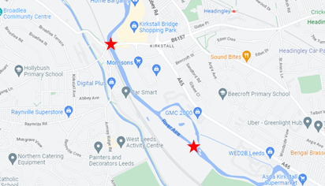
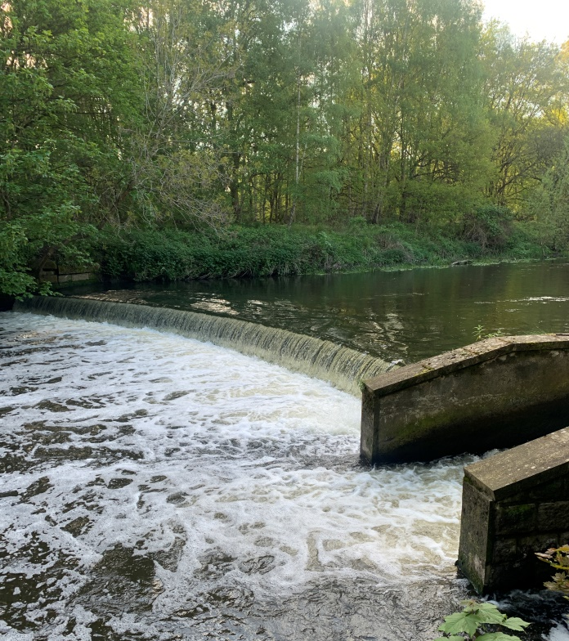

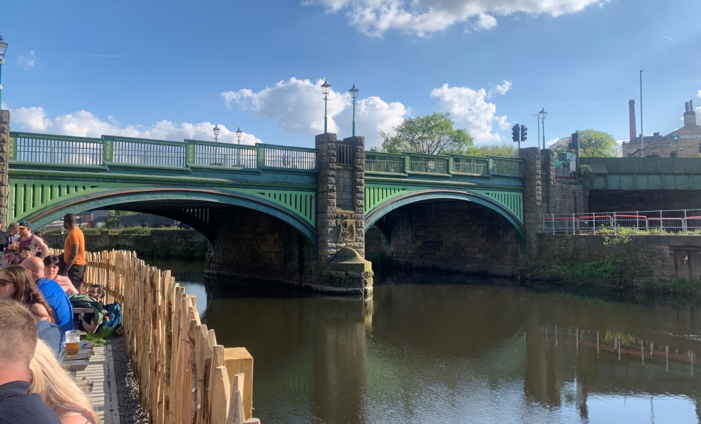
Plotting the river profile - River Aire

Slide 21
Plotting the river profile - River Aire
1.097 km stretch of the river between Kirkstall Bridge and the Kirkstall Valley Nature Reserve Weir
Choice of constants -
Use constants to plot the initial river height approximation and river height via backwards integration

Slide 22
Plotting the river profile - River Aire
The river bed function becomes
And the values are defined by
to 3 s.f. (unless stated otherwise)

Slide 23
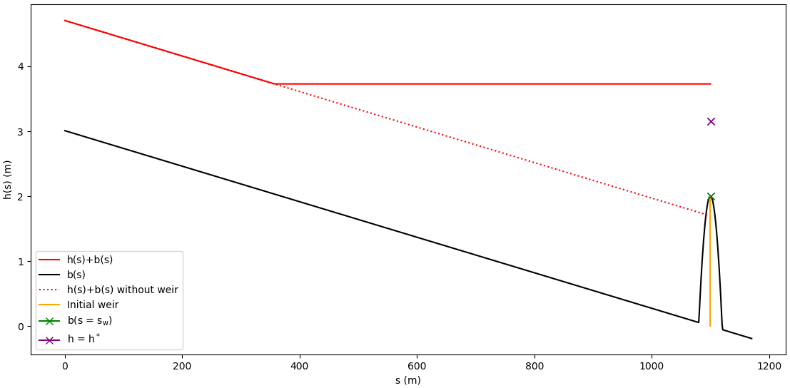
River plot over Kirkstall Valley Weir

Slide 24
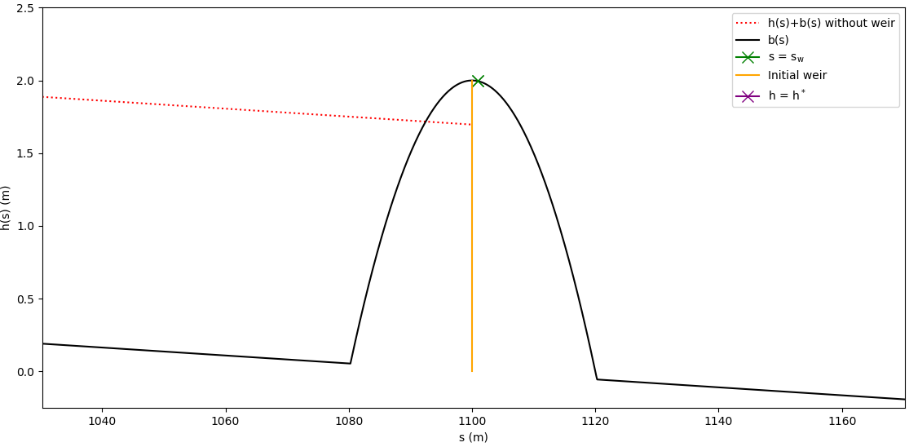
Plot zoomed in at the weir

Slide 25
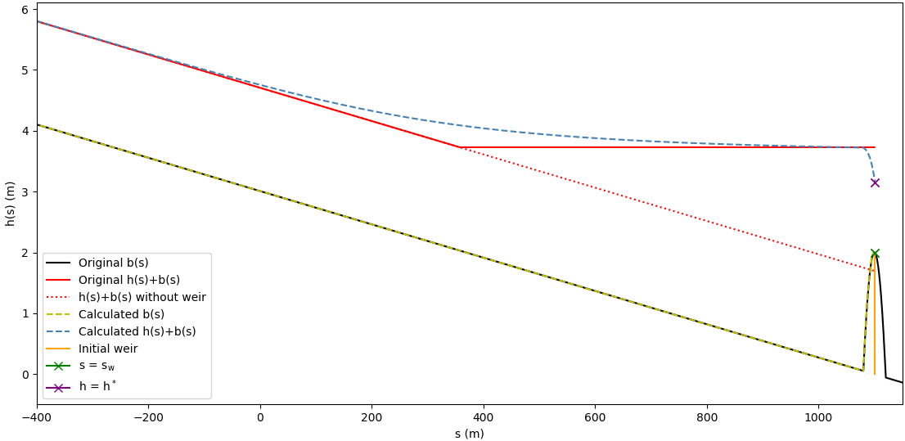
Plot over weir using backwards integration

Slide 26
Calculating Flood Storage Volume
FSV– Temporary storage of flood water to regulate flow downstream
FSV for river height approximation
FSV for backwards integration method
k
Ns points along [sₓ, sw] Ns points along [s₀, sw]

Slide 27
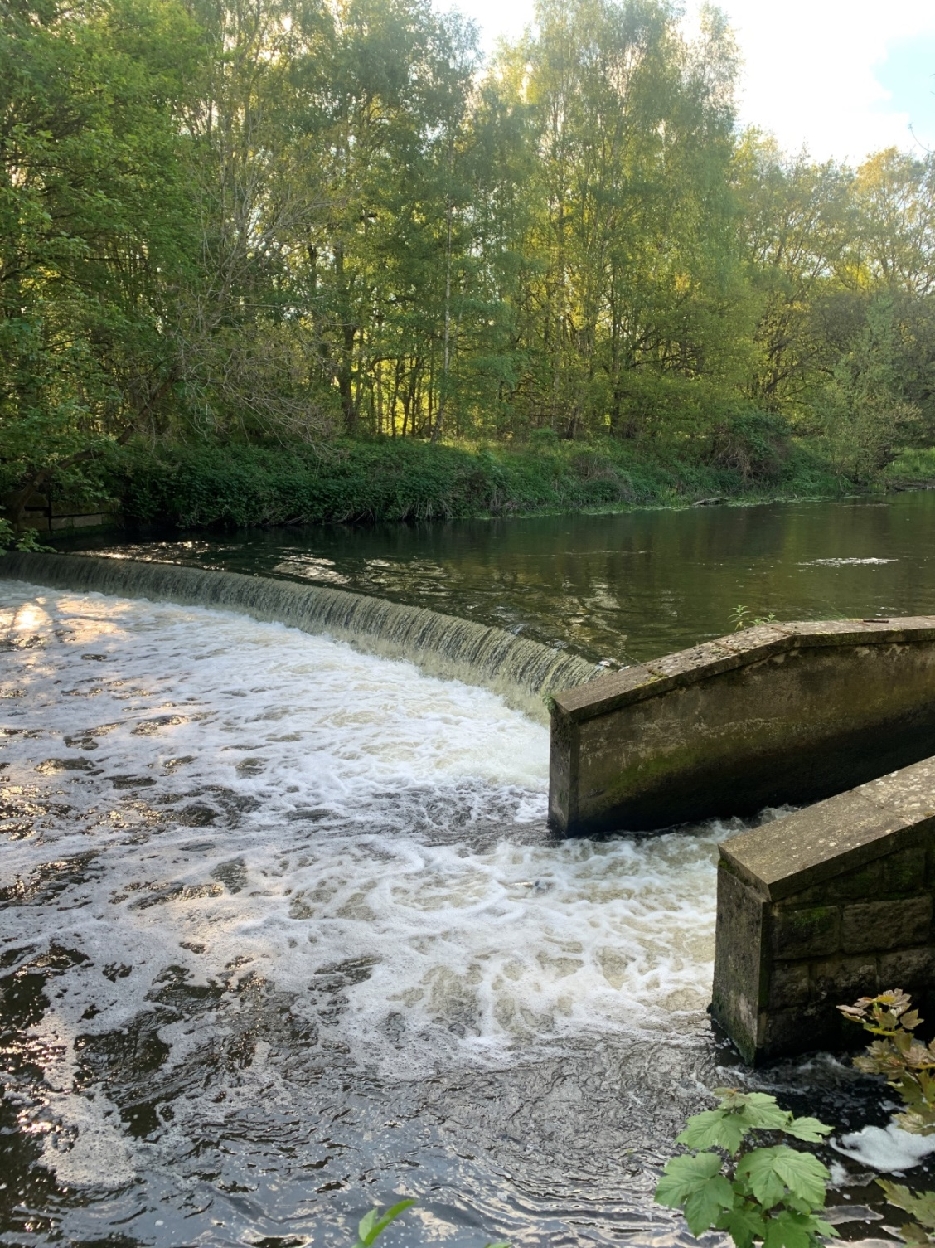
Alterations to the model
We find FSV₁ = 19478 m³ and FSV₂ = 22391 m³.
How does this change when we alter:
Weir height,
Discharge,
River bed slope?

Slide 28
Varying weir height

Slide 29
Varying discharge

Slide 30
Varying bed slope

Slide 31
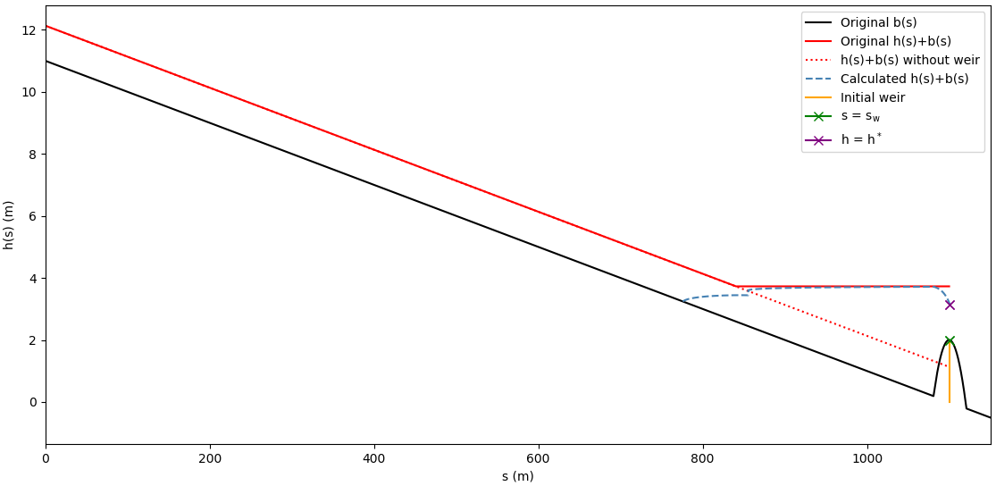
Varying bed slope
1
A relatively shallow river bed slope (1)
A relatively steep river bed slope (2)
2

Slide 32
Conclusion
☑
☑
Apply shallow water theory to model the behaviour of fluid passing over a weir
Explained the equation for discharge over a weir
Plotted the river profile over Kirkstall Weir
Calculate the flood storage volume created by a weir, applying this to a real life example
Calculated FSV over Kirkstall Weir
Investigated the properties that increase flood storage volume – a tall weir, shallow bed slope and high flow rate

Slide 33
Topics of Further Study
❑
❑
❑
Investigate river profile and FSV for:
- Different shaped weir crest – trapezoid, v-notch, parabolic
- Non-constant channel width or bed slope
- Different shaped channel
- Inclusion of a floodplain
Plotting river profiles for supercritical flow - steep slopes and high flow rates
Investigate river height and FSV over sharp-crested weirs

Slide 34
Do you have any questions?
Thank you
for watching!

